Slide 1

Chapter 8: Object and Class Structuring

Slide 2
Introduction
After defining the use cases (Chapter 6) and developing a static model of the problem domain (Chapter 7), the next step is to determine the software objects in the system, i.e. software objects that model real-world objects in the problem domain
Software objects are determined from the use cases and from the static model of the problem domain. This chapter provides guidelines on how to determine the objects in the system. Object structuring criteria are provided, and the objects are categorized by using stereotypes.

Slide 3
Contents
1. Object and class structuring criteria
2. Modeling application classes and objects
3. Object and class structuring categories
4. External classes and software boundary classes
5. Boundary classes and objects
6. Entity classes and objects
7. Control classes and objects
8. Application logic classes and objects

Slide 4
1. Object and class structuring criteria
There is no one unique way to decompose a system into objects, because the decisions made are based on the judgment of the analyst and the characteristics of the problem. Whether objects are in the same class or in a different class depends on the nature of the problem
Object and class structuring criteria are provided to assist the designer in structuring a system into objects. The approach used for identifying objects is to look for real-world objects in the problem domain and then design corresponding software objects that model the real world. After the objects have been identified, the interactions among objects are depicted in the dynamic model on communication diagrams or sequence diagrams, as described in Chapters 9 and 11.
Ex: Automobile and vehicle

Slide 5
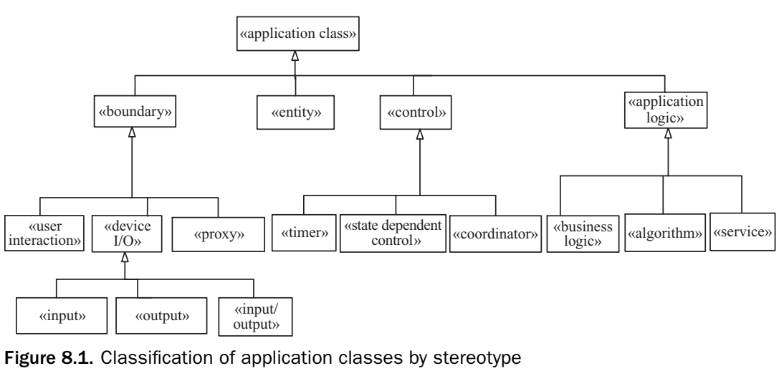
2. Modeling application classes and objects
Before dynamic modeling can be undertaken, it is necessary to determine what software classes and objects are needed to realize each use case.
In this step, classes are categorized in order to group together classes with similar characteristics.
This classification process is analogous to classifying books in a library

Slide 6
3. Object and class structuring categories
Objects and classes are categorized according to the roles they play in the application. There are four main object and class structuring categories:
Entity object (persistent) encapsulates information and provides access to the information it stores. In some cases, an entity object could be accessed via a service object.
Boundary object. Software object that interfaces to and communicates with the external environment:
User interaction object interacts with and interfaces to a human user.
Proxy object interfaces to and communicates with an external system or subsystem.
Device I/O boundary object receives input from and/or outputs to a hardware I/O device
Control object provides the overall coordination for a collection of objects. Control objects may be coordinator objects, state-dependent control objects, or timer objects
Application logic object are usually business logic objects, algorithm objects , service objects.

Slide 7
4. External classes and software boundary classes
External classes are classes that are outside the software system and that interface to the system. Boundary classes are classes inside the system that interface to and communicate with the external classes. To help determine the boundary classes in the system, it is necessary to consider the external classes to which they are connected. External classes interface to software boundary classes as follows:
An external user class interfaces to and interacts with a user interaction class.
An external system class interfaces to and communicates with a proxy class.
An external device class provides input to and/or receives output from a device I/O boundary class. Continuing with this classification:
An external input device class provides input to an input class.
An external output device class receives output from an output class.
An external I/O device class provides input to and receives output from an I/O class.
An external timer class signals to a software timer class

Slide 8
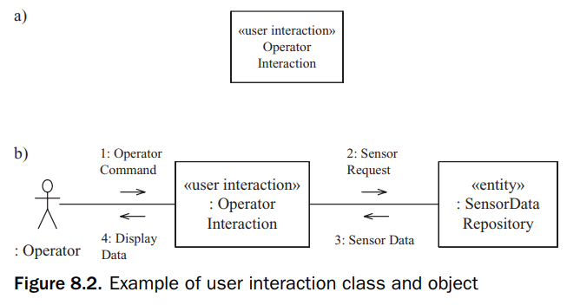
5. Boundary classes and objects
A user interaction object communicates directly with the human user, receiving input from the user and providing output to the user via standard I/O devices such as the keyboard, visual display, and mouse. This object is depicted with the «user interaction» stereotype.

Slide 9
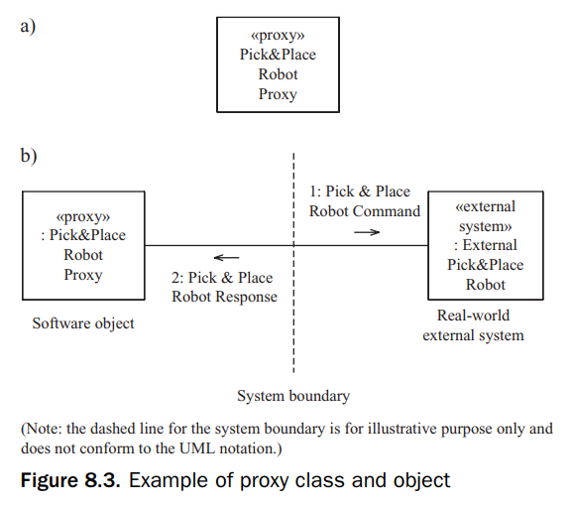
5. Boundary classes and objects
A proxy object interfaces to and communicates with an external system. The proxy object is the local representative of the external system and hides the details of “how” to communicate with the external system

Slide 10
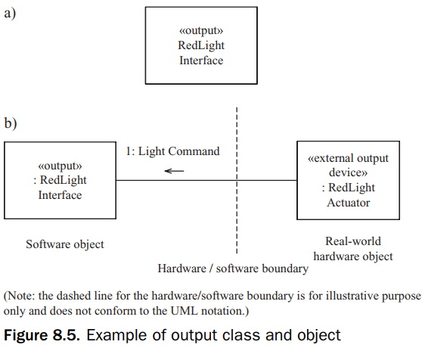
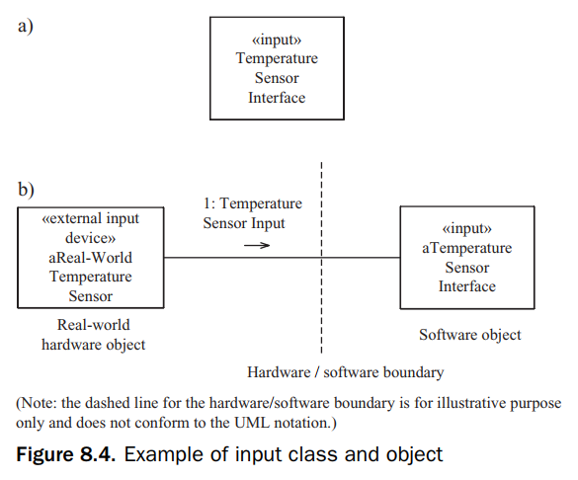
5. Boundary classes and objects
A device I/O boundary object provides the software interface to a hardware I/O device.
An input object is a device I/O boundary object that receives input from an external input device
An output object is a device I/O boundary object that sends output to an external output device

Slide 11
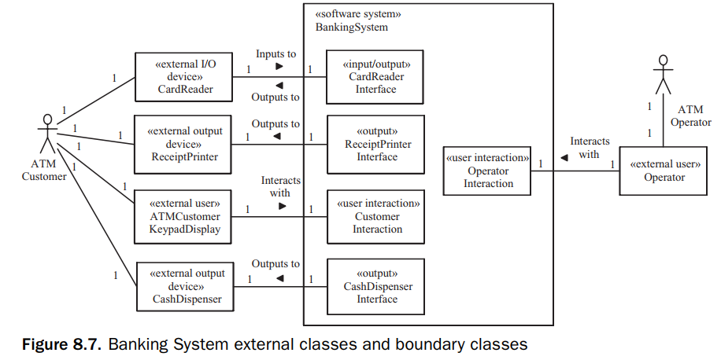
5. Boundary classes and objects
It is useful to expand software system context class diagram to show the boundary classes that communicate with the external classes. The boundary classes are software classes inside the system that are at the boundary between the system and the external environment.

Slide 12
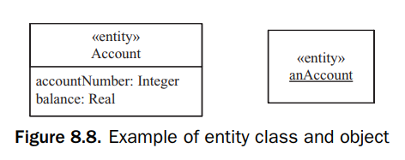
6. Entity classes and objects
An entity object is a software object that stores information.
In many information system applications, the information encapsulated by entity objects is stored in a file or database. In these cases, the entity object is persistent, meaning that the information it contains is preserved when the system is shut down and then later powered up

Slide 13
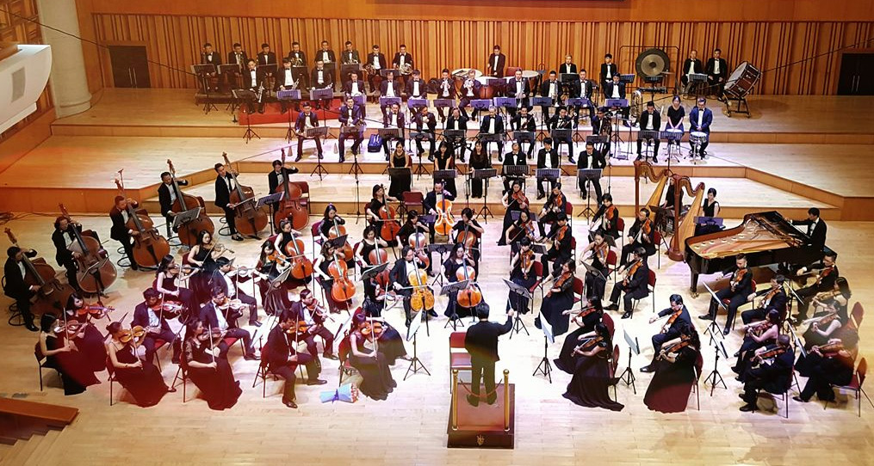
7. Control classes and objects

Slide 14
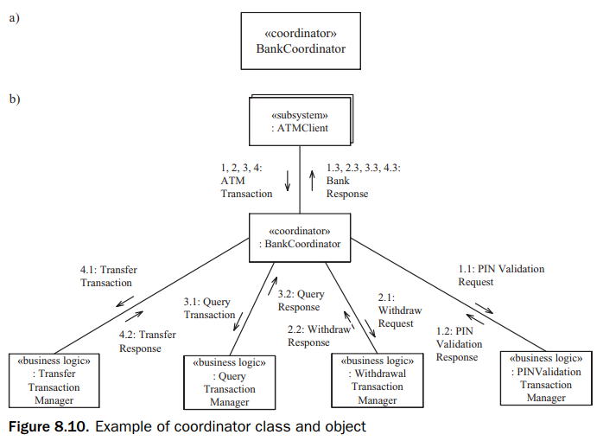
7. Control classes and objects Coordinator object
A control object provides the overall coordination of the objects that realize a use case. Simple use cases do not need control objects. However, in a more complex use case, a control object is usually needed.
A coordinator object is an overall decision-making object that determines the overall sequencing for a collection of related objects. A coordinator object is often required to provide the overall sequencing for the execution of a use case.

Slide 15
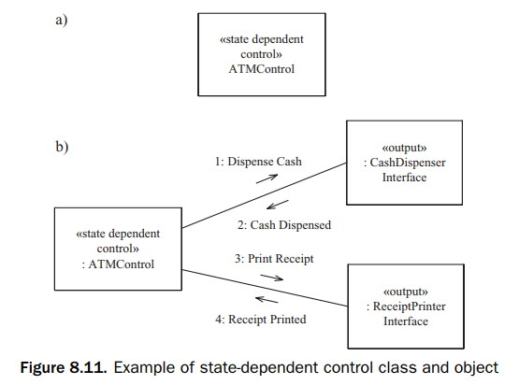
7. Control classes and objects State-dependent control object
A state-dependent control object is a control object whose behavior varies in each of its states. A finite state machine is used to define a state-dependent control object and is depicted by using a state chart.

Slide 16
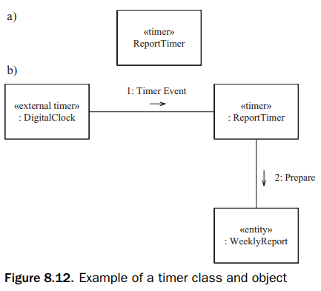
7. Control classes and objects Timer object
A timer object is a control object that is activated by an external timer – for example, a real-time clock or operating system clock. The timer object either performs some action itself or activates another object to perform the desired action.

Slide 17
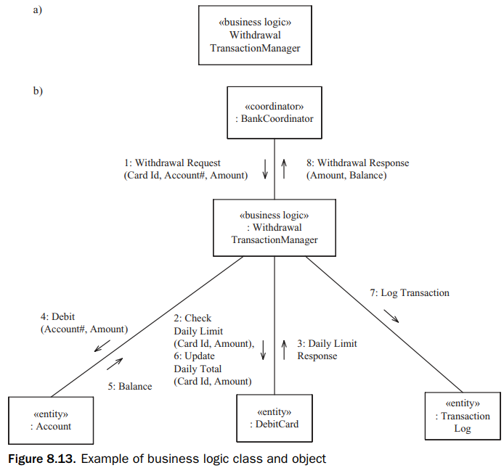
8. Application logic classes and objects Business logic object
A business logic object defines the business-specific application logic for processing a client request. The goal is to encapsulate (hide) business rules that could change independently of each other into separate business logic objects. Another goal is to separate the business rules from the entity data that they operate on, because the business rules can change independently of the entity data. Usually a business logic object accesses various entity objects during its execution.

Slide 18
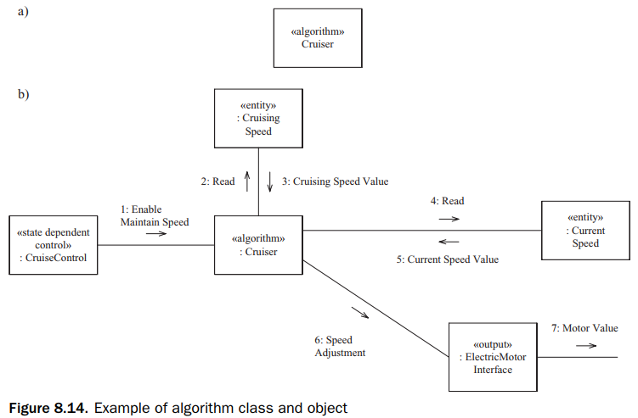
8. Application logic classes and objects Algorithm object
An algorithm object encapsulates an algorithm used in the problem domain. This kind of object is more prevalent in real-time, scientific, and engineering domains

Slide 19
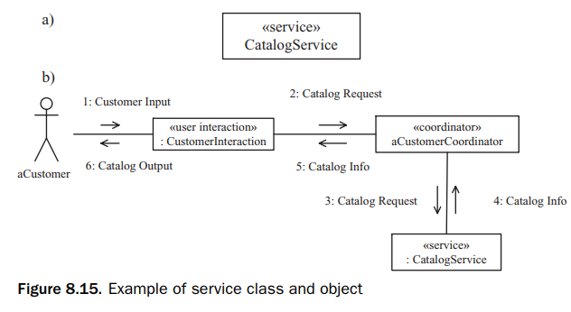
8. Application logic classes and objects Service object
A service object is an object that provides a service for other objects. They are usually provided in service-oriented architectures and applications

